Slide 1
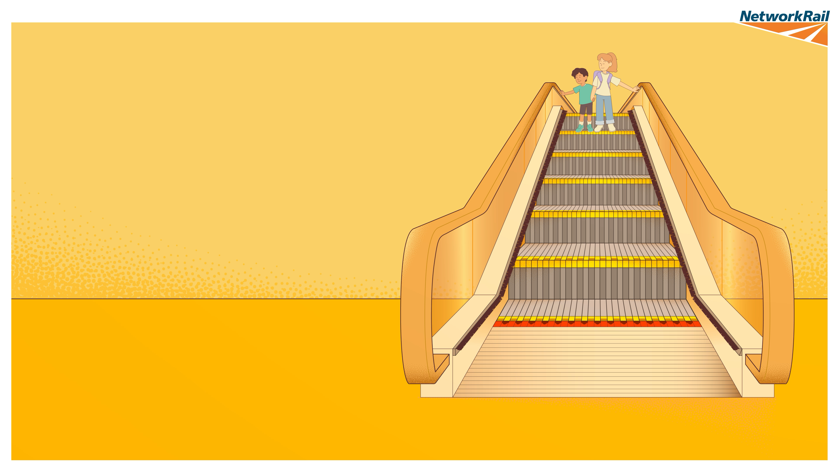
Ride the
escalator
like a pro!
2
It’s as easy as
1
3
Three steps
to a safer ride
Notes:
Escalators are a great way to help lots of people move around busy stations quickly and easily.
Every day, thousands of people use them safely. However, because escalators have moving steps and small gaps between parts, it's important to use them carefully. Sometimes, shoes, feet or other items can become trapped if people stand too close to the sides or aren't paying attention while riding.
Across our stations, there have been several accidents on our escalators in recent years. Most people travel safely every day, but these accidents remind us why it's important to know how to use escalators correctly. That's why we're sharing three easy steps that everyone can remember and follow.
Step 1: Hold tight. Hold the handrail while you're riding the escalator. This helps you keep your balance.
Step 2: Stand away from the sides. Keep your feet in the middle of the step and away from the sides and brushers of the escalator. This helps make sure your shoes and feet stay clear of moving parts and don’t get caught.
Step 3: Take a big step off. When you reach the end, look ahead and step off confidently. Don't stop at the top or bottom, as other people will be stepping off behind you.
By remembering these three simple steps, you can help make every escalator journey safe and enjoyable. So, remember:
Hold tight. Stand away from the sides. Take a big step off.
That's all it takes to ride an escalator like a pro.

